Slide 1
Estimation of E{Y_{h}}
A common objective is to estimate the mean for one or more conditional probability distributions of Y. That is, to estimate the mean of Y for a given value of X.
For example, the Toluca Company was interested in the mean number of work hours for particular lots sizes in order to find the optimum lot size.
Let X_{h} denote the level of X for which we wish to estimate the mean response.
X_{h} may be a value which occurred in the sample, or it may be some other value of the predictor variable within the scope of the model.

Slide 2
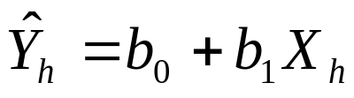
Estimation of E{Y_{h}}
The mean response when X=X_{h} is denoted as E{Y_{h}} and the point estimate is
The sampling distribution of Y_{h}(hat) is normal which follows from the fact that Y_{h}(hat) is a linear combination of the Y_{i}.
Y_{h}(hat) is an unbiased estimator of E{Y_{h}}

Slide 3
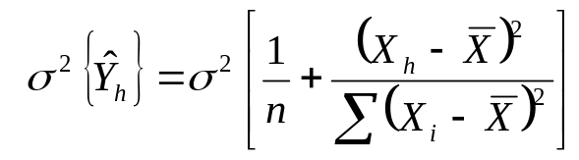
Estimation of E{Y_{h}}
The variance of Y_{h}(hat) is
When X_{h} is 0, this formula reduces to the formula we have for σ²{b₀ }.
Note that the farther X_{h} is from X(bar), the larger the variation in Y_{h}(hat)
Suppose we have two samples from the same experiment and both have the same set of X values. We then derive two regression lines based on these two samples.

Slide 4
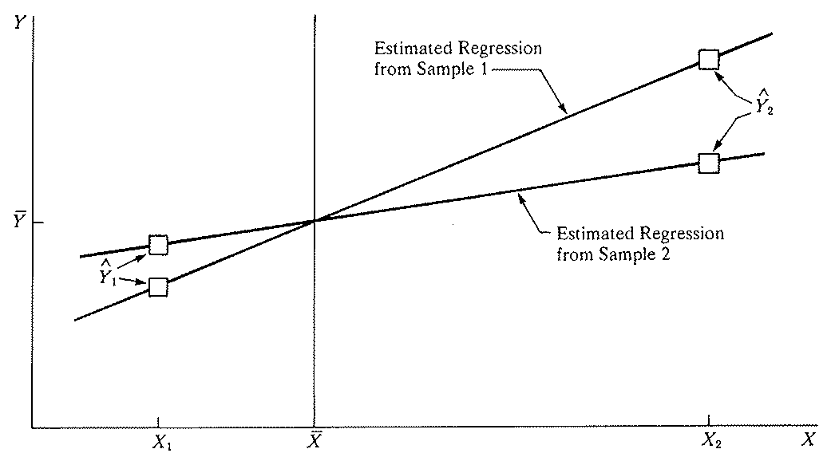
Estimation of E{Y_{h}}
Note at X₁, which is near X(bar), the two Y₁(hat)s from the two regression lines are close together, a result of the smaller variability.
Note at X₂, which is far from X(bar), the two Y₂(hat)s from the two regression lines are far apart, a result of the larger variability.

Slide 5
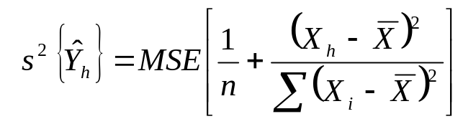
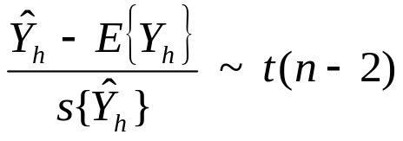
Estimation of E{Y_{h}}
As before we use the MSE in place of σ² to derive s²{Y_{h}(hat)}.
We have that
Thus the confidence intervals and hypothesis tests for E{Y_{h}} will be done similar to before as we did for β₀ and β₁.

Slide 6

Estimation of E{Y_{h}}
The (1-α)100% confidence limits are
For the Toluca example, we wish to calculate a 90% confidence interval for E{Y_{h}} when the lot size X_{h}=65
The point estimate is

Slide 7
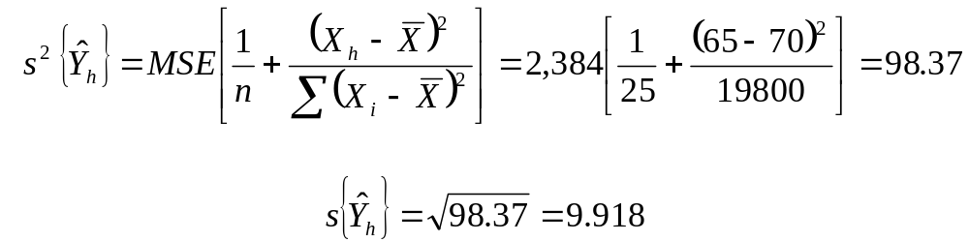
Estimation of E{Y_{h}}
We need to solve for s{Y_{h}(hat)}
For a 90% confidence interval we need t(.95,23) which equals 1.714.
Thus our confidence interval is 294.4 ± 9.918(1.714). This gives (277.4, 311.4)

Slide 8
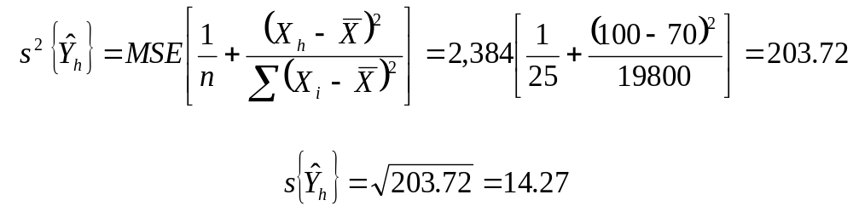
Estimation of E{Y_{h}}
Now, we calculate the 90% confidence interval for E{Y_{h}} when X_{h}=100. The point estimate is
and
Thus our confidence interval is 294.4 ± 14.27(1.714). This gives (394.9, 443.9)

Slide 9
Estimation of E{Y_{h}}
At X_{h}=65, the confidence interval for E{Y_{h}} is (277.4, 311.4).
At X_{h}=100, the confidence interval for E{Y_{h}} is (394.9, 443.9)
Note that the confidence interval at X_{h} = 100 is wider.
This is due to the fact that X_{h} = 100 is farther away from the mean X(bar)=70 than X_{h}=65.
Thus the variance of Y_{h}(hat) at X_{h} = 100, 203.72, is larger than the variance at X_{h}=65, 98.37. [SAS -meanci]

Slide 10
Prediction of new observation
We now consider the prediction of a new observation Y corresponding to a given level of X.
The new observation Y to be predicted is viewed as the result of a new trial, independent of the trials on which the regression analysis is based.
We denote the level of X for the new trial as X_{h} and the new observation on Y as Y_{h}(new).
Previously we discussed estimating the mean response E{Y_{h}}. Then, we were estimating the mean of the distribution of Y at X_{h}.

Slide 11
Prediction of new observation
Currently, we are predicting a new response Y_{h}(new).
We are predicting an individual outcome drawn from the conditional distribution of Y at X_{h}.
To illustrate, we assume that all the regression parameters are known.
We consider an example where we predict college GPA (Y) based on high school GPA (X). The regression parameters are σ=.12, β₀ = .1, β₁ = .95.
An admissions officer is considering an applicant whose high school GPA was X_{h}=3.5.

Slide 12
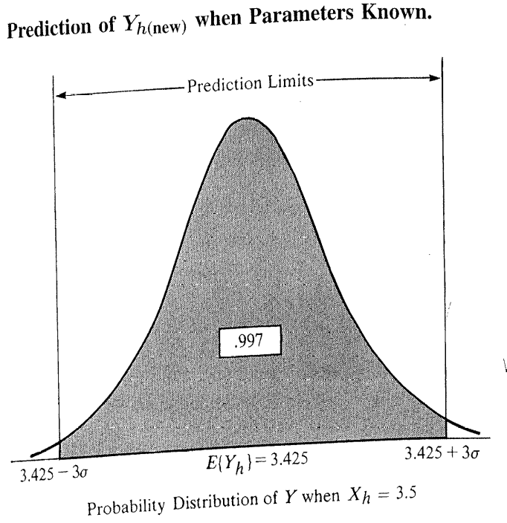
Prediction of new observation
The mean college GPA for students whose high school average is 3.5 is E{Y_{h}} = .1 + .95(3.5) = 3.425.
The figure shows the probability distribution of Y when X_{h} = 3.5. The distribution is normal with mean 3.425 and standard deviation .12.

Slide 13
Prediction of new observation
We could predict that the college GPA of an applicant whose high school GPA is X_{h} =3.5 will be between:
E{Y_{h}} ± 3σ = 3.425 ± 3(.12)
Thus the prediction interval is (3.065, 3.785)
Since 99.7% of the area in a normal probability distribution falls within 3 standard deviations from the mean, the probability is .997 that this prediction interval will give a correct prediction.
In general, when the parameters are known the 1-α prediction limits are
E{Y_{h}} ± z_{1-α/2} σ

Slide 14
Prediction of new observation
In reality, we rarely know the regression parameters and they need to be estimated.
As usual, the mean of the conditional distribution of Y is estimated by Y_{h}(hat) and the variance of the conditional distribution of Y is estimated by the MSE.
However, we can not simply use the prediction limits calculated with the parameters replaced with their estimates.
Consider a confidence interval (L,U) for E{Y_{h}}.

Slide 15
Prediction of new observation
Since E{Y_{h}} is believed to be in between the interval (L,U), E{Y_{h}} could be as far left as L, as far right as U, or somewhere in between.
L
U

Slide 16
Prediction of new observation
The figure also shows the prediction limits for Y at the two end values of the interval for E{Y_{h}}.
The prediction limits when E{Y_{h}}=L is L ± z_{1- α/2} σ
The prediction limits when E{Y_{h}}=U is U ± z_{1- α/2} σ.
L
U

Slide 17
Prediction of new observation
The figure also shows the prediction limits for Y at the two end values of the interval for E{Y_{h}}.
The prediction limits when E{Y_{h}}=L is L ± z_{1- α/2} σ
The prediction limits when E{Y_{h}}=U is U ± z_{1- α/2} σ
L
U

Slide 18
Prediction of new observation
Since we can not be certain of the E{Y_{h}} and the corresponding location of the distribution of Y_{h}, prediction limits for Y_{h}(new) must take into account two elements.
Variation in the possible location of the distribution of Y (that is the variation in the location of E{Y_{h}} )
Variation within the probability distribution of Y for a given E{Y_{h}}
L
U

Slide 19
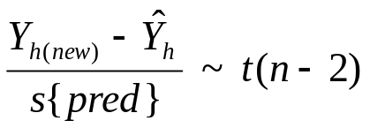
Prediction of new observation
Prediction limits for a new observation Y_{h}(new) at a given level of X_{h} are obtained using
The point estimator Y_{h}(hat) is used since the true mean E{Y_{h(new)}} is unknown.
The numerator represents how far the new observation Y_{h}(new) is from the estimated mean Y_{h}(hat), based on the original n cases.

Slide 20
Prediction of new observation
This difference can be viewed as the prediction error, with Y_{h}(hat) serving as the best point estimate of the value of the new observation.
We use the independence of the new observation and the original n cases to derive the variance of this prediction error.
Note, σ²{pred} has two components
The variance of the sampling distribution of Y_{h}(hat): σ²{Y_{h}(hat)}. This is the variation in the estimated mean of the distribution of Y at X = X_{h}.
The variance of the distribution of Y at X = X_{h}: σ² . This is the variation within the distribution of Y at X = X_{h}.

Slide 21

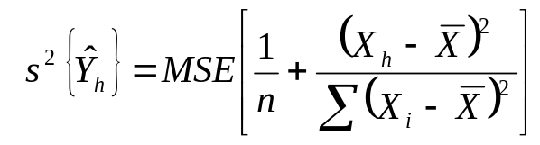
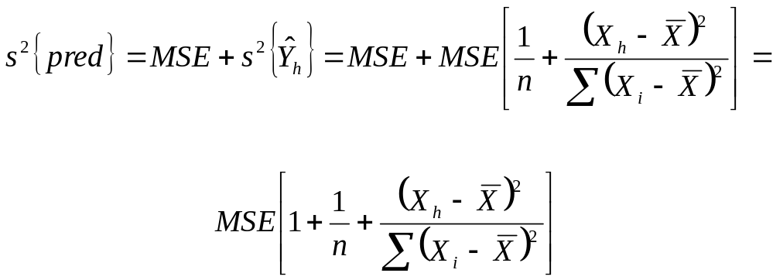
Prediction of new observation
An unbiased estimator of σ²{pred} that uses the MSE is s²{pred} where
Recall,
Thus,

Slide 22
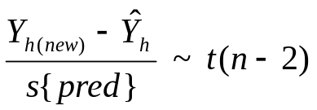

Prediction of new observation
Recall that
It follows that a (1-α)100% prediction interval for Y_{h}(new)is
For example, we will do a 90% prediction interval for the Toluca example when X_{h}=100.

Slide 23
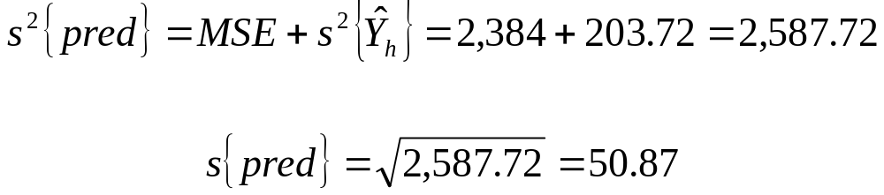
Prediction of new observation
Recall that,
Y_{h}(hat) = 419.4 s²{Y_{h}(hat)} = 203.72 MSE = 2,384 t(.95,23) = 1.714
So the 90% prediction interval for Y_{h}(new) is
This gives (332.2, 506.6)

Slide 24
Prediction of new observation
With 90% confidence, we predict that the number of work hours for the next production run of 100 units will be somewhere between 332 and 507 hours.
Note, the main reason for the interval being so large is the large variability in work hours for any given lot size.
This is the variance of the distribution of Y at X = X_{h}, estimated by the MSE, which accounts for 92% of the estimated prediction variance.
This may be a result of the fact that other factors besides lot size account for the variability in work hours. (SAS- pred)

